Slide 1
Group3
Member of the group
1.THIDA
2.EM CHA
3.CHUN SOCHING
Topic : PROS AND CON OF USING FACEBOOK
Facebook can help us reduce stress
Facebook can make us money
Casy dissemination of information and know speedy dissemination information in Facebook
Affects children and adults
Facebook can be Reduces intimacy with family and friends
Facebook Can cause addiction

Slide 2

Facebook can make us money
How should we make money from Facebook?
Sell products
Attractive video making

Slide 3

Facebook can help us reduce stress
What kind of Facebook should we look at to reduce stress?
Funny
Listen music
See stories related to nature

Slide 4
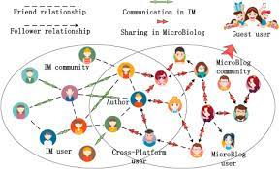
Casy dissemination of information and know speedy dissemination information in Facebook

Slide 5

Affects children and adults
Facebook can make you addicted ,when we addicted ,it can make affect
Such as
-Irritability and mood swings
-anxiety and depression
-insomnia craving,fatigue,
aches and pains, and nausea
-Job loss

Slide 6

Facebook can be Reduces intimacy with family and friends

Slide 7

Facebook Can cause addiction
Facebook can make you addicted ,when we addicted ,it can make affect
Such as
-Irritability and mood swings
-anxiety and depression
-insomnia craving,fatigue,
aches and pains, and nausea
-Job loss

